Slide 1


AWS Lambda Kole Vasilevski, Principal Software Engineer

Slide 2
Lambda
Lambda is a serverless and an event-driven compute service.
Lambda executes your code only when needed and scales automatically.
Lambda functions are stateless – no affinity to the underlying infrastructure.
You choose the amount of memory you want to allocate to your functions and AWS Lambda allocates proportional CPU power, network bandwidth, and disk I/O.

Slide 3
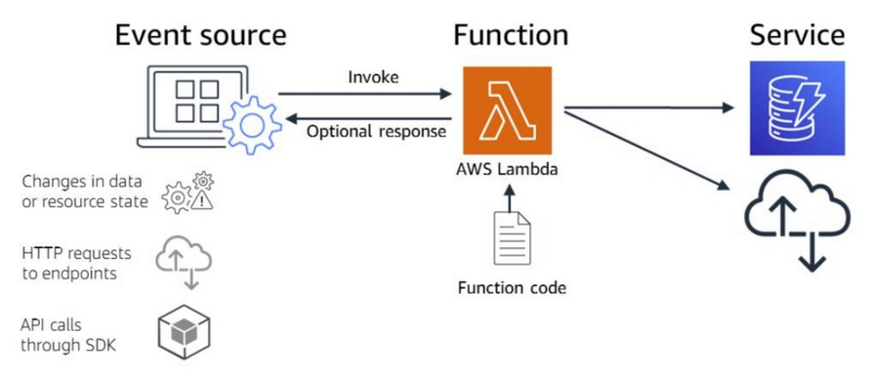
Lambda Using

Slide 4
Lambda Languages
Node.js
Java
C#
Go
Python
Ruby
PowerShell

Slide 5
Lambda Components
Function – a script or program that runs in Lambda. Lambda passes invocation events to your function. The function processes an event and returns a response.
Runtimes – Lambda runtimes allow functions in different languages to run in the same base execution environment. The runtime sits in-between the Lambda service and your function code, relaying invocation events, context information, and responses between the two.
Layers – Lambda layers are a distribution mechanism for libraries, custom runtimes, and other function dependencies. Layers let you manage your in-development function code independently from the unchanging code and resources that it uses.
Event source – an AWS service or a custom service that triggers your function and executes its logic.

Slide 6
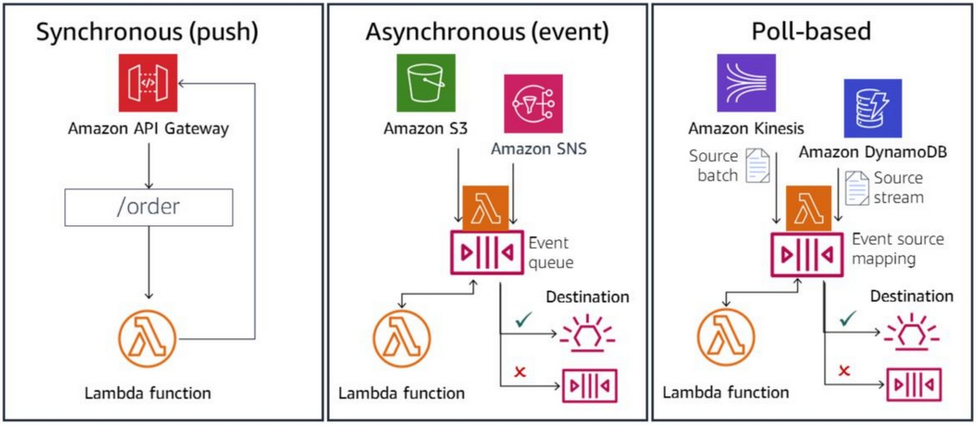
Lambda Ways to invoke

Slide 7
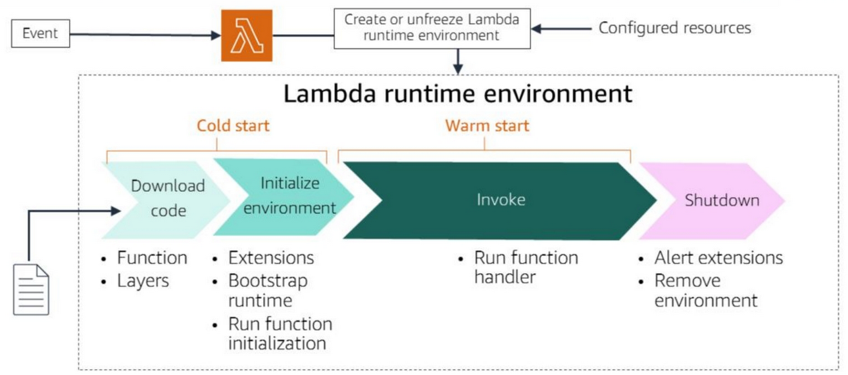
Lambda Runtime lifecycle

Slide 8
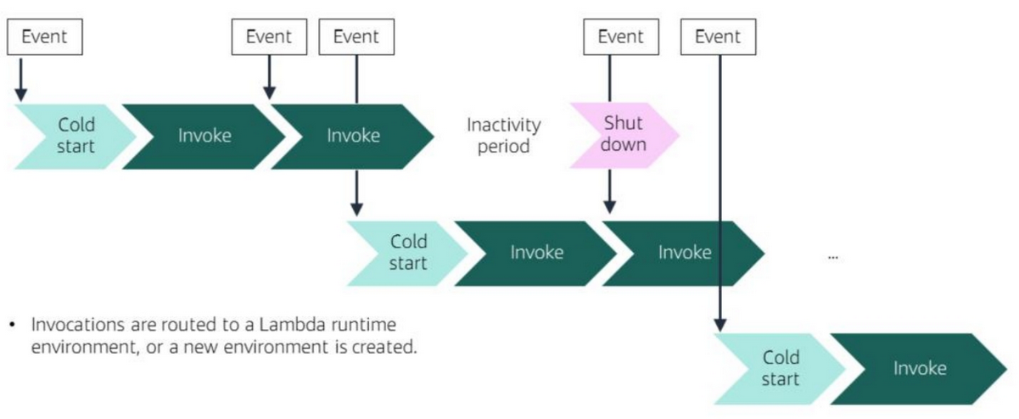
Lambda Concurrency

Slide 9
Lambda Execution context
When your Lambda function gets called, Lambda will then invoke your function in an execution environment, which is an isolated runtime environment. The execution context is a temporary runtime environment that initializes any external dependencies of your lambda code. This execution context reuse approach has the following implications:
Any declarations in your Lambda function code (outside the handler code) remains initialized, providing additional optimization when the function is invoked again.
Each execution context provides 512 MB of additional disk space in the /tmp directory. The directory content remains when the execution context is frozen, providing transient cache that can be used for multiple invocations.
Background processes or callbacks initiated by your Lambda function that did not complete when the function ended resume if AWS Lambda chooses to reuse the execution context.

Slide 10

Lambda Demo in AWS Console

Slide 11

Lambda Demo .NET Code

